Slide 1
SKILLY
Primary wellbeing,
made gentle.
Everything your school needs to deliver the new Primary Wellbeing Specification (SPHE & PE) for 3rd–6th Class — and the evidence it produces on the way.
skilly.ie/prime · Demo: skilly.ie/demo/prime

Slide 2
WHERE PRIMARY SCHOOLS ARE RIGHT NOW
A new wellbeing curriculum, and no textbook.
The specification landed
Every teacher starts from scratch
And it still has to be evidenced
The NCCA Primary Wellbeing Specification (SPHE + PE, 2025) sets out what every school must now teach across 3rd–6th Class.
No textbook, so the quality of a child's wellbeing education depends on which class they happen to be in, and how much time that teacher had.
Cuntas Míosúil every month, SSE on its cycle, DEIS reporting if you're a DEIS school. All of it written up after the teaching is done.
Skilly Prime is the programme and the paperwork in one place, so the wellbeing curriculum lands the same way in every classroom.
Skilly Prime · Primary wellbeing, made gentle
2

Slide 3
MADE FOR PRIMARY, NOT SHRUNK DOWN FROM POST-PRIMARY
Four things that make it feel right in a primary room.
📖
Think · Pair · Story · Share
🎨
Every lesson has its own picture
A gentle four-step rhythm: think on your own, turn and talk, share a story, then a short reflection. 9-to-12-year-olds aren't small teenagers.
An illustration tied to the learning outcome — on the card, the slides and the printable plan. No clip-art hunting the night before.
👆
One-tap reflections
🎉
A “Well done!” for every child
A tap and a few words. Drawing counts as reflecting at this age. Low reading load, no blank-page dread.
Every reflection ends with a celebration and a warm message. Wellbeing should feel good to do.
Skilly Prime · Primary wellbeing, made gentle
3

Slide 4
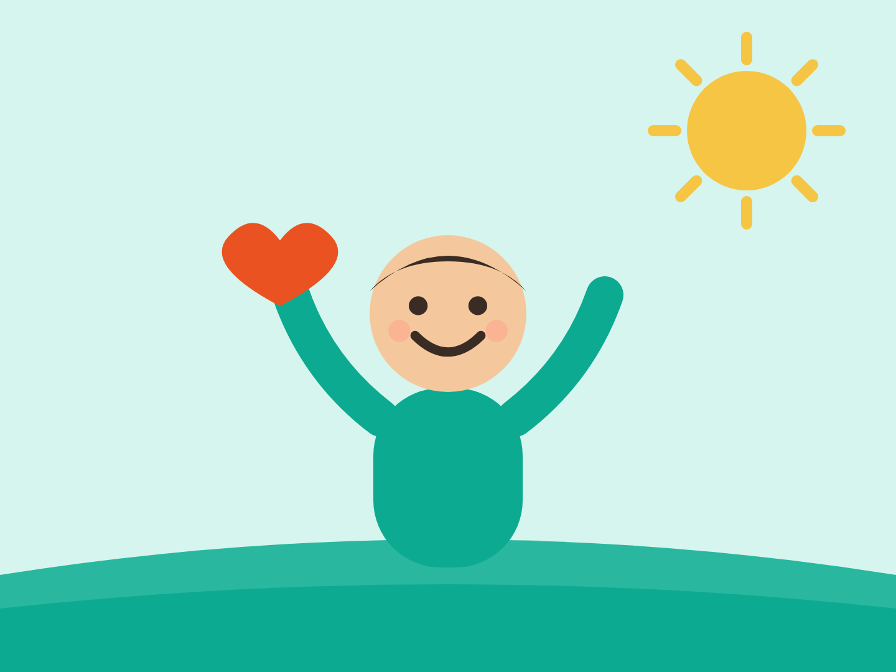


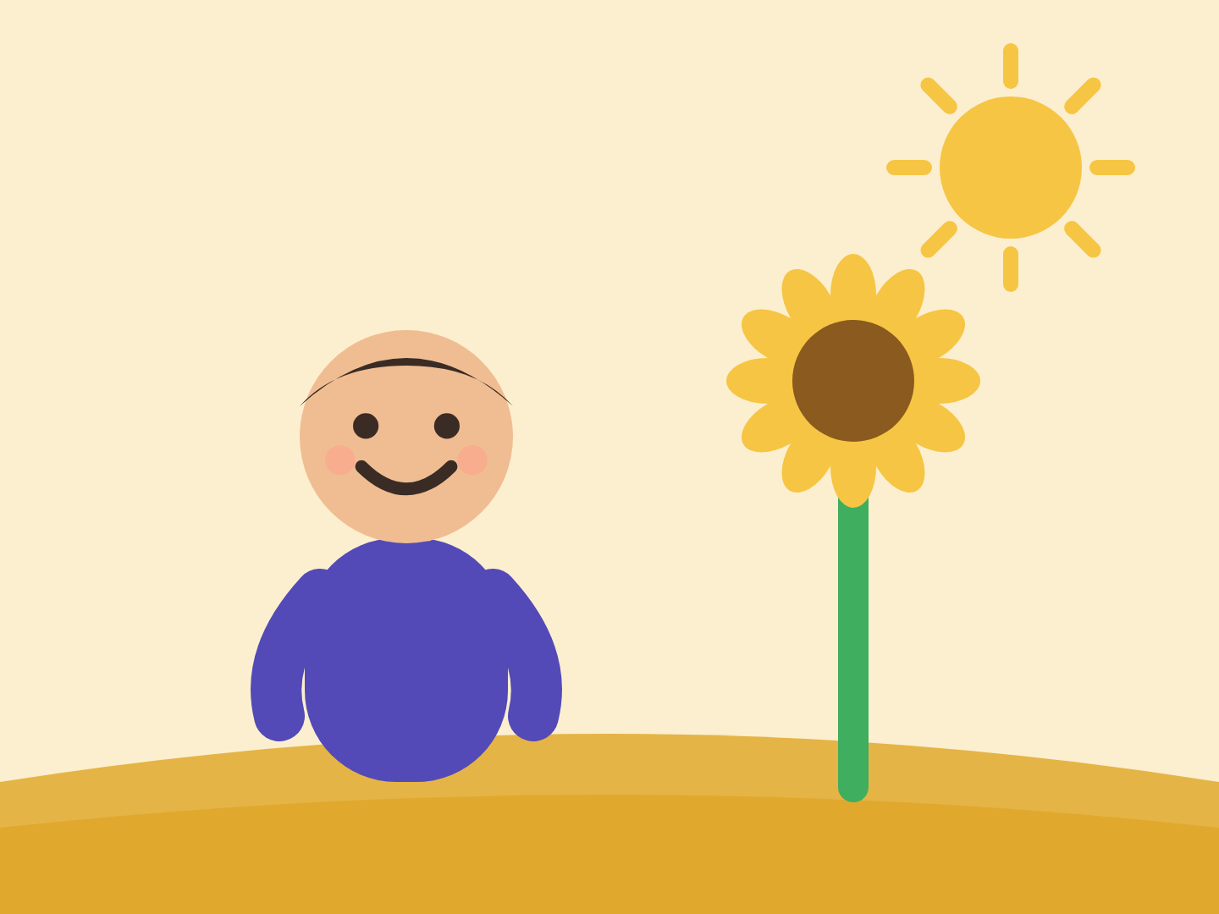
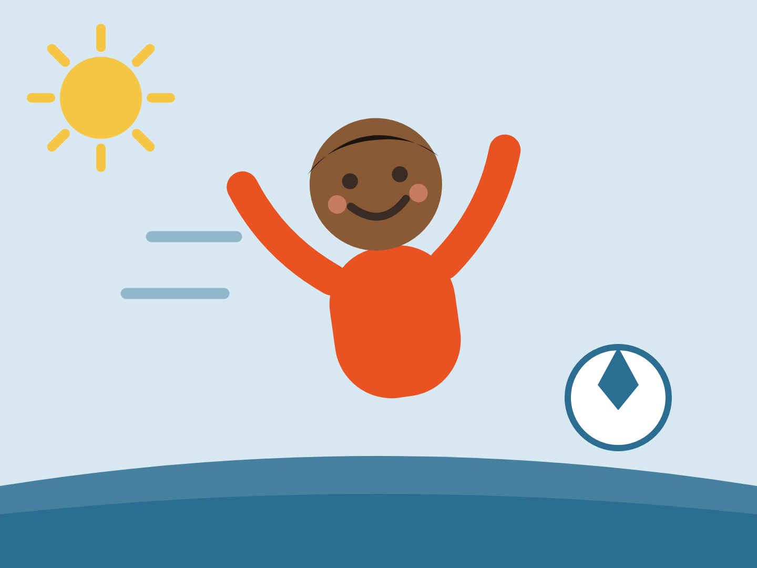
THE WHOLE CURRICULUM, COVERED
39 lessons across the five strands.
P1
P2
P3
P4
PM
Wellbeing
Me & My Relationships
Me & the Wider World
Growing & Changing
Movement & Me
These are the actual illustrations from the product — the same scenes your pupils see on the whiteboard and on the printable plan.
Growing & Changing (Strand 4) is off by default. Your school turns it on when your policy and your parents are ready — not before.
Skilly Prime · Primary wellbeing, made gentle
4

Slide 5
WHAT A LESSON ACTUALLY LOOKS LIKE
Thirty minutes, four steps, nothing to prepare.
1
2
3
4
Think — just you
Pair — turn and talk
Story — what would you do?
Share — journal time
A question on the board and a quiet moment. Every child gets to have their own answer first.
Two minutes with the person beside them. The children who never put a hand up still get to speak.
A short story from a child's life, and a class conversation about it. This is where the teaching happens.
One tap, a few words or a drawing. Then a “Well done!”, and the evidence is recorded.
The teacher opens it on the whiteboard and presses go. The slides, the talking points, the teacher notes and the illustration are already there — and the whole plan downloads as a PowerPoint or PDF for the folder.
Skilly Prime · Primary wellbeing, made gentle
5

Slide 6
EVIDENCE WITHOUT THE EXTRA EVENING
The wellbeing paperwork, already done.
NCCA Primary Wellbeing Specification
Cuntas Míosúil, sorted
Lessons map to the 2025 specification (SPHE + PE) across its strands: Wellbeing, Relationships, The Wider World, Growing & Changing, and Movement.
Every lesson is tagged to its strand and learning outcome, so the wellbeing line in your monthly Cuntas Míosúil writes itself.
SSE that fits primary
DEIS, the primary way
Self-evaluation uses “Looking at Our School 2022” (Primary) and the four Wellbeing areas. Your coordinator portal only ever shows the primary version.
DEIS reporting recognises the primary bands — Urban Band 1, Urban Band 2 and Rural — so you see the right language, not post-primary terms.
The record builds itself while the lessons are being taught, rather than being written up afterwards.
Skilly Prime · Primary wellbeing, made gentle
6

Slide 7
WHO IT'S FOR
One programme, three different days made easier.
👧
🧑‍🏫
📋
For the child
For the class teacher
For the coordinator
A calm, friendly place to think about how they feel: one tap, a few words or a drawing, and a “Well done!” every time.
Open the lesson, project the slides, press go. Illustrations, talking points and teacher notes are already there — minutes of prep, not an evening.
A primary-only portal: SSE, Cuntas Míosúil and DEIS evidence in primary language, with nothing borrowed from post-primary.
Ar fáil as Gaeilge: every lesson, prompt and piece of feedback is available in Irish, for Gaelscoileanna and any school teaching wellbeing through Irish.
Skilly Prime · Primary wellbeing, made gentle
7

Slide 8
WHERE THE ADULTS STAY IN CHARGE
Skilly supports the people who know the child. It never replaces them.
The teacher signs off everything
Skilly drafts warm, formative feedback on a child's reflection. The teacher reads it, changes anything they want, and decides when the child sees it.
Concerns go to a named adult
If something in a reflection suggests a child needs a second look, Skilly raises it for a trained adult in your school to review. It never diagnoses, labels, or acts on its own.
Your school controls the sensitive content
Growing & Changing is opt-in, per school. Nothing in that strand appears until you switch it on.
Skilly Prime · Primary wellbeing, made gentle
8

Slide 9
FOR YOUR DPO AND YOUR BOARD
The data questions, answered up front.
EU
0
Hosted in the EU (Frankfurt). Pupil data does not leave the EEA.
Pupil work is never used to train an AI model, and is never sold or shared.
GDPR
Redacted
Your school is the data controller. Article 28(3) DPA and a DPIA are available on request.
Names, emails, phone numbers, addresses, Eircodes and PPSNs are stripped before any text reaches the AI, which runs under a zero-retention contract.
Full detail: the sub-processor list, AI transparency note and DPIA are all published at skilly.ie.
Skilly Prime · Primary wellbeing, made gentle
9

Slide 10
WHAT LANDS, AND HOW QUICKLY
One price for the school, and a launch that takes an afternoon.
Included for every school
1
Send us your class list
39 lessons for 3rd–6th Class, across all five strands
Whiteboard presenter mode — open it and teach
Every lesson as a printable plan: PowerPoint and PDF
Pupil reflections with feedback the teacher signs off
Coordinator year plan and scheme of work for Rang 3–6
SSE, Cuntas Míosúil and DEIS evidence as you go
A parent letter, in plain English
Every lesson and prompt available in Irish
One CSV. We set the school up.
2
A short remote launch
About half an hour with your staff.
3
Teach the first lesson
That same week, on the whiteboard.
One flat price per school, whatever your enrolment — no counting pupils, no per-module add-ons. DEIS discount available. Ask us for your school's number.
Skilly Prime · Primary wellbeing, made gentle
10

Slide 11
Have a look before you talk to anyone.
The demo drops you straight into a real primary school — lessons, pupil view, coordinator portal — with no sign-up and nothing to install.
skilly.ie/demo/prime
Or book a 30-minute walkthrough and we'll go through it with your team.
skillycare@skillysolutions.com
+353 87 418 8829
skilly.ie/prime
Skillscan Limited · CRO 565995 · VAT IE3375591CH · Foxrock, Dublin 18

